Slide 1
Genetic tests for Ataxia
Bahareh Rabbani, PhD
Medical Genetic

Slide 2
Purpose
Diagnosis : extensive clinical overlap
Multigene analysis
>300 hereditary disorders associated with ataxia
common causes are expansion of nucleotide repeats within 7 genes: ATXN1, ATXN2,
ATXN3, ATXN7, ATXN8, CACNA1A (spinocerebellar ataxia type 6), and FXN (Friedreich ataxia)
Exome sequencing????

Slide 3
Ataxia
Neurological syndrome
Hyperkinetic movement disorder with distinguishing features that include irregular movements, decreased coordination and balance, kinetic tremor, wide-based stance, and dysarthria
Hereditary ataxia, sporadic ataxia
Age, disease time course, and family history
Hereditary ataxia (100): slowly progressive incoordination of gait, poor coordination of the upper extremities, abnormal eye movements, and dysarthria

Slide 4
Family history
Mode of inheritance
Autosomal recessive
Autosomal dominant
Others-x-linked related or mitochondrial disorders, errors of metabolism
Sporadic

Slide 6
Molecular genetic testing
Single gene
Panel
Whole exome sequencing
Clinical utility: testing for genetic conditions that have potential therapies or directly change management decisions

Slide 7
Single gene

Slide 8
Panel gene
sequence analysis,
deletion/duplication analysis,
specific assays for nucleotide repeats
or other nonsequencing-based tests

Slide 9
Whole exome sequencing
200-500 variants
Pathogenicity?
variants of uncertain significance
additional testing of relatives
Missed the correct diagnosis
Or unrelated genes or variants

Slide 10
Patient
Ataxia
Clinical symptoms, brief clinical description, age at onset of first symptoms
Informed consent
Family history

Slide 11
Family history
7 years

Slide 12
WES result
Gene | variant | Protein | Allele state | Exon/ Intron | Inheritance | classification
APTX | c.601C>T | p.Gln201Ter | hom | Exon 6 | Autosomal recessive | pathogenic
Gene | Location | phenotype | Phenotype MIM number | Inheritance
APTX | 9p21.1 | Ataxia, early-onset, with oculomotor apraxia and hypoalbuminemia | 208920 | AR

Slide 13
classification
Hereditary ataxia (family history)
Autosomal dominant ataxia (e.g. SCA >40 types): SCA1, SCA2, SCA3
Autosomal recessive ataxia (e.g. SCAR: Friedreich ataxia, ataxia-telangiectasia
X-linked ataxia (e.g. SCAX: X-linked ataxia, ATP2B3
Mitochondrial (POLG)
Sporadic ataxia (not having a family history)

Slide 14
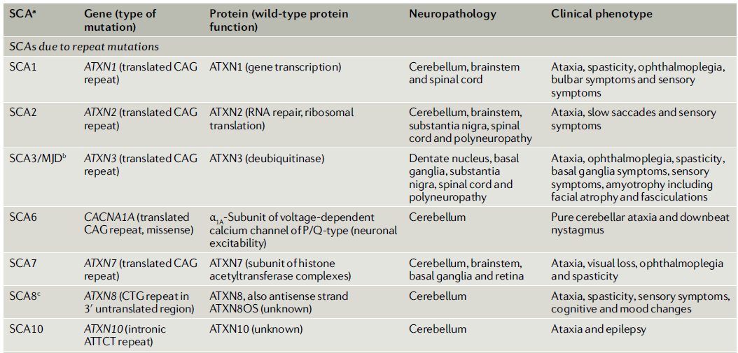
SCAs due to repeat mutations

Slide 15
molecular genetic diagnosis of SCAs

Slide 16
Repeat expansions that cause ataxia

Slide 17
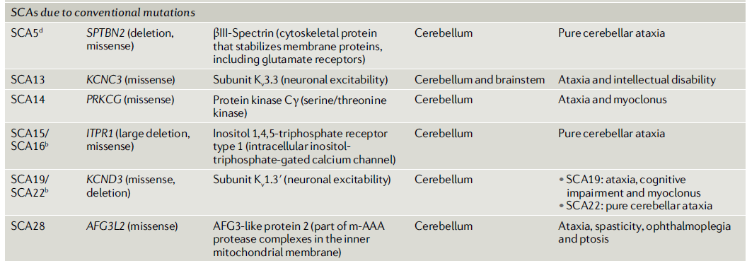
SCAs due to conventional mutations

Slide 18
Genetic tests
Single gene (Nt expansion repeats, sequencing, MLPA, Capillary, fragment analysis)
Targeted exome sequencing
Whole exome sequencing

Slide 19
